Slide 1

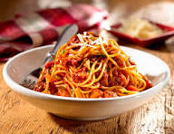

EMILY SOPHIA RIVERA RAMIREZ 2AVP
.

